Slide 1


Project Stage-II
“Real Estate CRM”
Date- 29 January, 2019
Submitted to:
Dr. Sunil Kumar Jangir
(HOD IT)
Mr. Naveen Kedia
(Project Incharge)
Mr. Piyush Gautam
(Project Guide)
Submitted by:
Tanushri Goyal
Manisha Shekhawat
Sanchit Bhargava Rahul Soni

Slide 2
Contents
1. Problem Statement ….. 3
2. Objectives ….. 4
3. UML Diagram ….. 5
4. Requirement Analysis ….. 6
Project Scope ….. 7
Progress Till Date .…..8
Screenshots ……9

Slide 3
Problem Statement
System may be defined as a layered structure that depicts how programs involved would interrelate and communicate. In computers, System may also include actual programs, programming interfaces and tools for managing the larger system. The term system may be used differently in different contexts, but more or less the concept remains the same. Real Estate CRM provides multiple services related to real estate services. This application consists of multiple modules, which further contain different systems along with the implementation of their defined constraints.
Basically, systems are implemented for providing simple manual processes and that is exactly what we are trying to achieve. System is implemented as per user requirement such as a manufacturing concern may install a plant for easing out manual processes. We have sought help from computer programming for automation of manual registration system. With the introduction of computers, every aspect of our lives has been revolutionized. When used judiciously, computers can help us save time, secure our personal information, access the required information whenever and wherever required. Keeping all these positive points in mind, we have developed a Real Estate CRM for easily providing the services facilities for the student in an application.

Slide 4
Objective
This is an Online real estate CRM through which a user can access its information and manage all the adding, updating, deleting the assets and some of its tasks.
The benefits desired would be more than the cost of computerization in terms of increased business, better controls & fix prize of services. From the description of the present system & problems with the existing system one can gauge the manpower wasted in these activities even then it’s difficult to gain access it. Addition, updating, modifying and deleting records is very easy in the Business Generation system. Just on the click of fingers different data can be accessed. So, here lies the need for a change from the old age system.

Slide 5
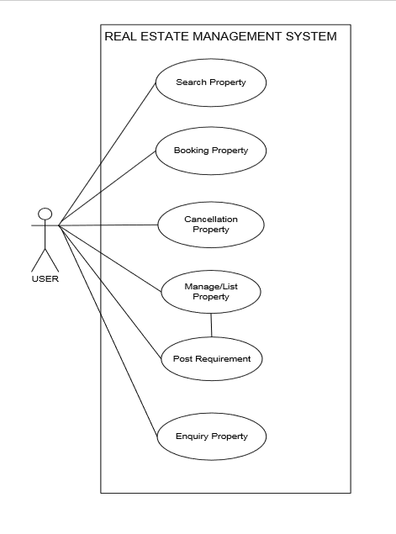
UML Diagram

Slide 6
Project Scope
The real of CRM have spread across millions of households, so naturally, Internet has become by far the best platform for real estate marketing today. Now a days when everything is online, how is it possible that real estate left web application behind? There are lots of real estate companies who advertise their property online so idea behind developing this application is that their property can also sell, or buy or even rent property using this. These applications are not widely popular but in future, they have large scope of growth. This CRM is an online real estate management through which individual agents or buyer can maintain their property document keeping and managing property registration and also access its information and manage all the adding, updating, deleting the ads and some of its tasks. The Admin user can inform their agents for regarding to property and update the information regarding property and cancellation of property or changing buyer choice.
The system is very useful for the companies or builders that can post and edit the information of their properties and their personal info and admin can monitor records of all of them. The system is also useful which also keeps track of Account details of buyers and Investors and also RES Industry

Slide 7
Technical Requirements
Hardware Requirement
RAM: 4 GB.
Hard Disk: 500GB.
Processor: Pentium 4.
Software Requirement
Operating System: Any OS
Any Version of browser after Mozilla Firefox 4.0, Internet Explorer 6.0.

Slide 8
Progress Till Date
Study about Salesforce CRM:- We have firstly studied about the salesforce CRM. The need of this new system and the benefits that will be provided to the user, so basically the research was been done on the existing system.
Suitable Objects:- To store and retrieve information we have made the use of some standard objects such as Products, Accounts and opportunities.
Implementation:- We have worked on the project by using the product object while adding some required fields in that and created some opportunities and through which we can make a track that to whom the selling has been made.

Slide 9
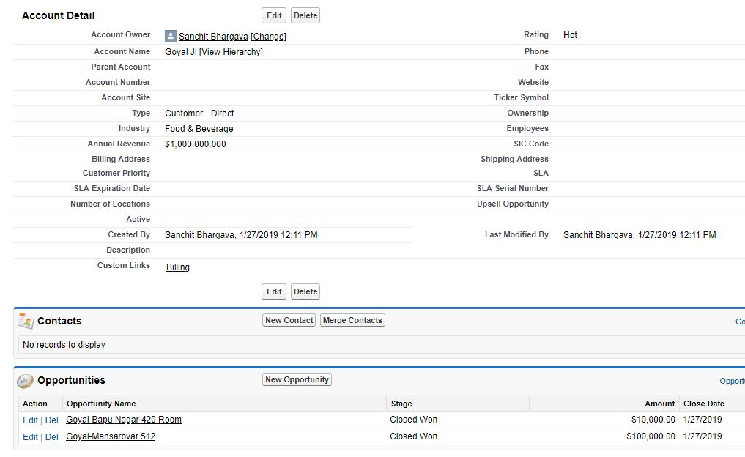
Screenshots

Slide 10
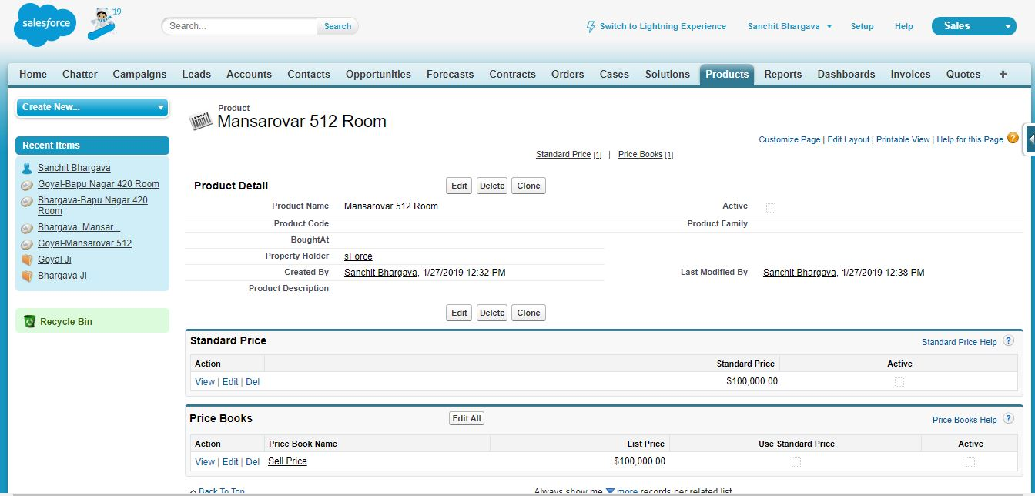
Screenshoots

Slide 11
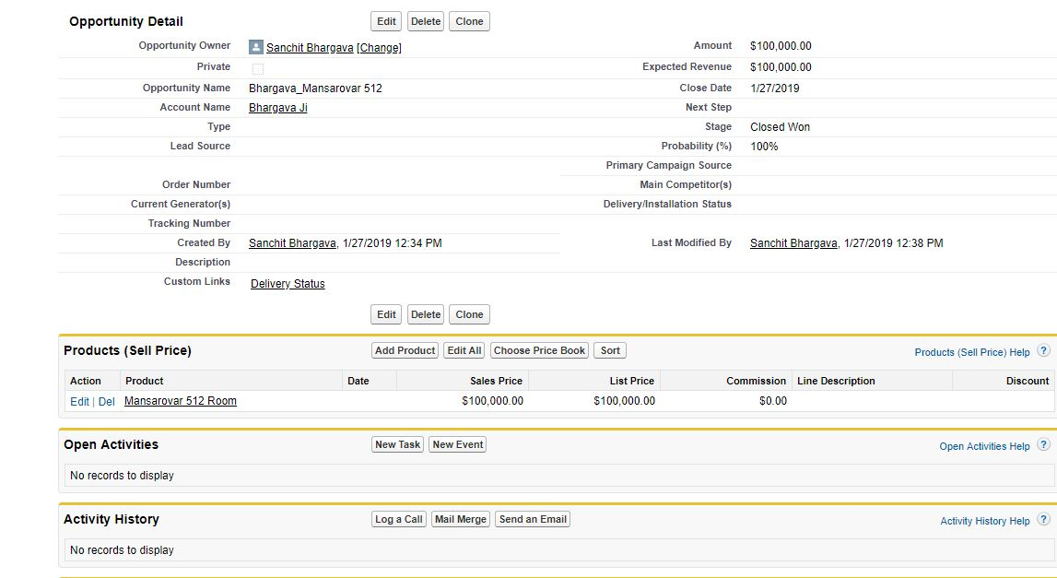
Screenshoots

Slide 12
Thank You

